Slide 1






Institute of Technology of Cambodia
Payroll Management System
Data Structure and Programming II | Group I2-GIC-2
Academic Year 2025-2026
Team 3
S. Manutnithya
e20240477
T. Chan Dara
e20240165
T. Sovanoudom
e20240794
T. Bounthet
e20240920
Notes:
Good morning, Teacher and my teammate. We are Team 3 from Group I2-GIC-2. Today, we are proud to present our final project for the Data Structure and Programming II course: A Payroll Management System. This system was developed for the 2025-2026 academic year to demonstrate how programming logic can solve real-world administrative challenges."

Slide 2
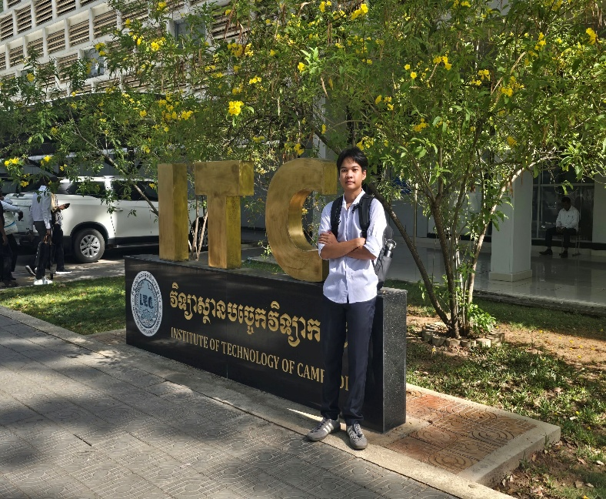



Institute of Technology of Cambodia
Our Team Members
Sean Manutnithya
Taing
Chan Dara
Tang Sovanoudom
Thon Bounthet
Notes:
Before we dive into the technical details, let us introduce Our Team member behind this project. Our team consists of:
Sean Manutnithya(leader team) , member. Each member played a vital role in integrating data structures with functional payroll logic.

Slide 3
Institute of Technology of Cambodia
TEAM MEMBER CONTRIBUTIONS
Members' Name
Role
SEAN MANUTNITHYA
Leader / Dividing Task / Error checks and fixes / Record, Search and Sort /
Time and attendance / Edit Video
TAING CHAN DARA
Program Menu / Tax information / Salary and Tax deduction / Calculate Salary after Deduction / Error checks and fixes
TANG SOVANOUDOM
Project Report / Payment and Pay Schedule / Search and Sort Algorithm / Error fixes
THON BOUNTHET
Project Slide / Calculate Salary after Deduction / Payroll Submission to government / Error fixes
Notes:
To ensure the success of this project, we divided our tasks based on system modules: Take charge

Slide 4
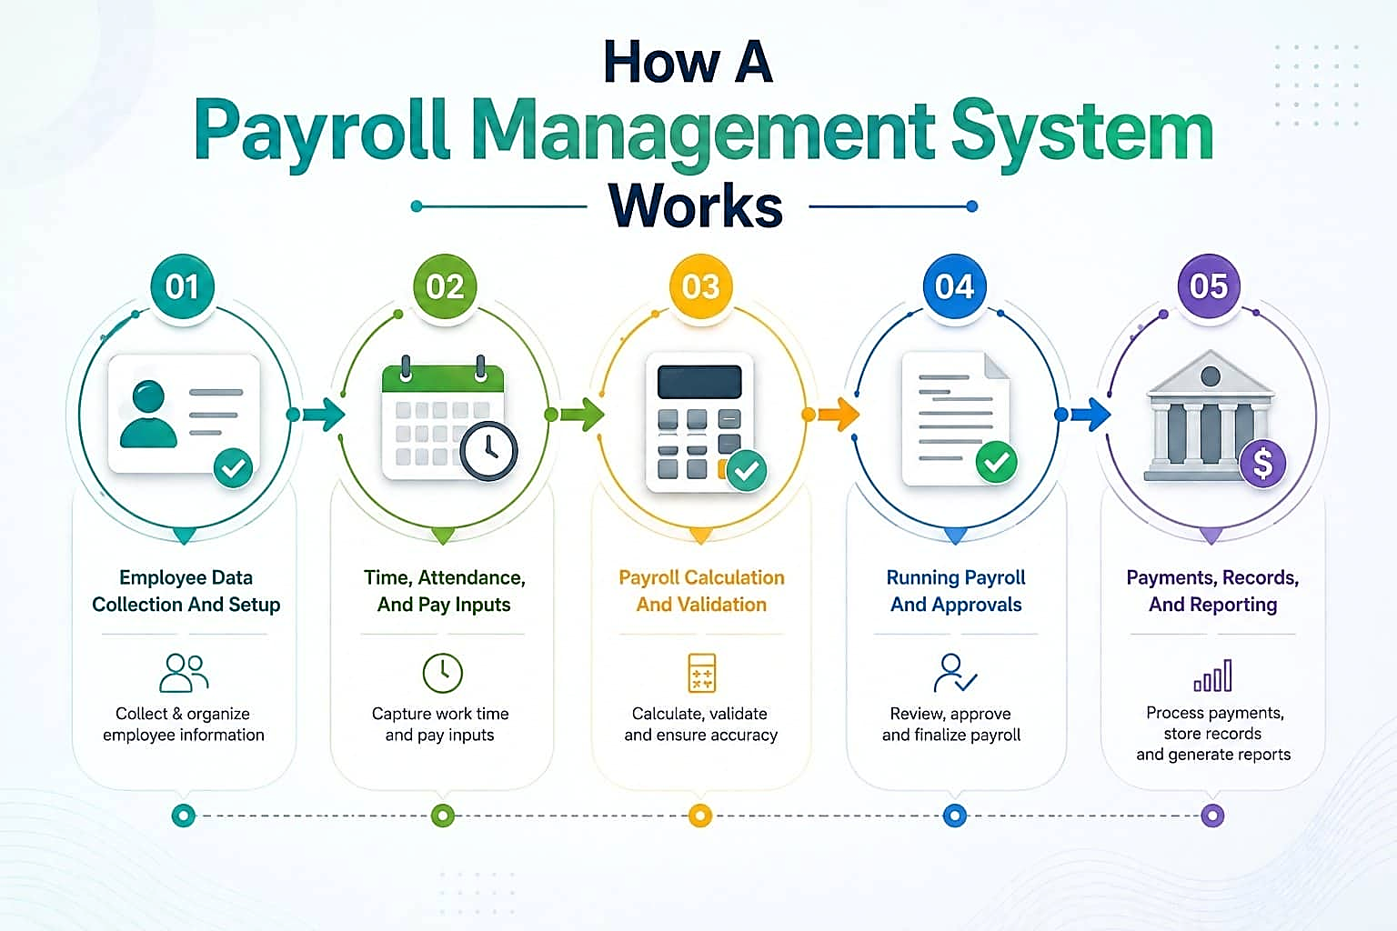
02. Core System Features
Employee management, attendance tracking, and search functions.
06. Conclusion & Demonstration
Summary of achievements, learning outcomes, and future upgrades.
01. Introduction & Purpose
Real-World importance and objectives of a Payroll Management
Institute of Technology of Cambodia
Table Of Content
03. Technical Implementation
Programming Language environment and key C++ Modules.
05. System result
Output Validation, test cases and tax report verification.
04. Data Structure & Logic
Doubly Linked Lists, CSV File handling, and algorithms.

Slide 5
Institute of Technology of Cambodia
Table Of Content
01. Introduction & Purpose
Real-World importance and objectives of a Payroll Management
02. Core System Features
Employee management, attendance tracking, and search functions.
06. Conclusion & Demonstration
Summary of achievements, learning outcomes, and future upgrades.
05. System result
Output Validation, test cases and tax report verification.
03. Technical Implementation
Programming Language environment and key C++ Modules.
04. Data Structure & Logic
Doubly Linked Lists, CSV File handling, and algorithms.
Notes:
Our presentation is divided into six key chapters:
1.Introduction & Purpose: Why we built this.
2.Core System Features: A look at the modules.
3.Technical Implementation: Our coding environment.
4.Data Structure & Logic: The 'brain' of the system (Linked Lists).
5.System Results: Validation and output.
6.Conclusion & Demo: Summary and a live look at the code."

Slide 6





Institute of Technology of Cambodia
Introduction & Purpose
Payroll management Payroll management is a critical organizational process. Our C++ based system automates complex tasks to ensure accuracy in compensation.
Automated working hours tracking.
Precise tax and overtime deduction.
Lightweight CSV file data persistence.
Notes:
Why automate payroll? Manual payroll is prone to human error and is time-consuming. Our system uses C++ to provide:
-Auto
-Pre
-Ligh
To give you a high-level overview, our system follows a 5-step workflow: First, Employee Data Collection, where we gather profiles. Second, Time and Attendance, where we capture hours worked. Third, the Calculation phase, where we validate tax and overtime. Fourth, Approvals, where the payroll is finalized. And finally, Reporting, where the system generates the payments and stores records in CSV files.

Slide 7
PAYROLL MANAGEMENT SYSTEM
Institute of Technology of Cambodia
01
MAIN
PAYROLL PROCESSING HUB
Core System Features
Central system managing all payroll operations, employee records, tax calculations, and payment scheduling.
DATA SOURCES
Employee Management
The foundation of the system is the Employee Record module, which maintains essential data:
Unique Employee ID and Name validation.
Role-based attributes (Position, Dept).
Wage parameters (Monthly Salary, Hourly Rate).
Contact Info (Phone Number, Gender).
INPUT FILES
02
employee_list.csv
tax_information.csv
attendance.csv
RECORD MANAGEMENT
03
SEARCHING | SORTING
Manage and organize all employee records. Search and sort employee data for efficient payroll processing.
CALCULATE SALARY AND DEDUCTION
NET SALARY COMPUTATION
04
Compute the final net salary for each employee after applying all deductions and tax reductions. Reference: final_salary.csv
TRACK TIME & ATTENDANCE
05
ATTENDANCE TRACKING
Monitor and record employee working hours, overtime, and attendance data for accurate payroll calculation.
PAY SCHEDULE
PAYMENT PLANNING
06
Organize and schedule payment dates for all employees. Manage pay periods and ensure timely disbursement of salaries.
TAX INFORMATION
07
TAX PROCESSING
Retrieve and process tax information for each employee including federal, state, and local tax rates.
PAY EMPLOYEES
SALARY DISBURSEMENT
08
Execute salary payments to all employees via direct deposit or check. Confirm successful payment transactions.
CALCULATE REDUCTION
09
DEDUCTIONS & BENEFITS
Calculate all applicable deductions including taxes, benefits, insurance, and other withholdings from gross salary.
SUBMIT PAYROLL TAX
TAX FILING & PAYMENT
10
Submit payroll tax payments and filings to relevant authorities. Reference: tax_report.csv | tax_filling_history.csv
PAYROLL MANAGEMENT FLOWCHART
Notes:
This flowchart represents the architecture of our software. At the center is the Main Payroll Processing Hub. It pulls data from three sources:
Like employee_list.csv, tax_information.csv, and attendance.csv.

Slide 8
PAYROLL MANAGEMENT SYSTEM
01
MAIN
PAYROLL PROCESSING HUB
Central system managing all payroll operations, employee records, tax calculations, and payment scheduling.
DATA SOURCES
INPUT FILES
02
employee_list.csv
tax_information.csv
attendance.csv
RECORD MANAGEMENT
03
SEARCHING | SORTING
Manage and organize all employee records. Search and sort employee data for efficient payroll processing.
CALCULATE SALARY AND DEDUCTION
NET SALARY COMPUTATION
04
Compute the final net salary for each employee after applying all deductions and tax reductions. Reference: final_salary.csv
TRACK TIME & ATTENDANCE
05
ATTENDANCE TRACKING
Monitor and record employee working hours, overtime, and attendance data for accurate payroll calculation.
Institute of Technology of Cambodia
PAY SCHEDULE
PAYMENT PLANNING
06
Core System Features
Organize and schedule payment dates for all employees. Manage pay periods and ensure timely disbursement of salaries.
TAX INFORMATION
Employee Management
The foundation of the system is the Employee Record module, which maintains essential data:
Unique Employee ID and Name validation.
Role-based attributes (Position, Dept).
Wage parameters (Monthly Salary, Hourly Rate).
Contact Info (Phone Number, Gender).
07
TAX PROCESSING
Retrieve and process tax information for each employee including federal, state, and local tax rates.
PAY EMPLOYEES
SALARY DISBURSEMENT
08
Execute salary payments to all employees via direct deposit or check. Confirm successful payment transactions.
CALCULATE REDUCTION
09
DEDUCTIONS & BENEFITS
Calculate all applicable deductions including taxes, benefits, insurance, and other withholdings from gross salary.
SUBMIT PAYROLL TAX
TAX FILING & PAYMENT
10
Submit payroll tax payments and filings to relevant authorities. Reference: tax_report.csv | tax_filling_history.csv
PAYROLL MANAGEMENT FLOWCHART
Notes:
The system branches into specific tasks:
Record Management for sorting.
Attendance Tracking for NSSF and deductions.
Net Salary Computation which leads to the final step: Disbursement and Tax Filing. Every box you see here represents a specific C++ function we wrote."

Slide 9




Institute of Technology of Cambodia
Tracking & Searching
Attendance Tracking
Records working hours, presence, and overtime. Automatically updates employee stats and prepares values for the final payroll calculation.
Linear Search Function
Quickly locate records using Employee ID. The system traverses the linked list to display relevant payroll and personal details instantly.
Notes:
Two of our most important modules are Attendance Tracking and Linear Searching. The Attendance module doesn't just record presence; it calculates overtime hours which directly impacts the 'PayOT' variable in our formula. For searching, we implemented a Linear Search Function. Because we use a Linked List, the system traverses each node, checking the Employee ID until it finds a match, displaying their full payroll profile instantly.

Slide 10
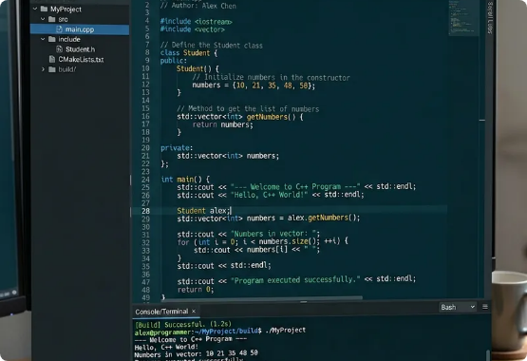
Institute of Technology of Cambodia
Technical Implementation
The system is built as a console-based C++ application, prioritizing performance and modularity.
Language: C++ (Double Linked List and File IO).
Modules: Separate headers for Records, Attendance, and Tax Calculation.
Persistence: CSV format for lightweight data storage and portability.
Notes:
Technically, the system is built using C++ with the Double Liked List and File IO. We followed a Modular Programming approach. Instead of one giant file, we used separate headers for different responsibilities: Student.h (or Employee structs), Attendance.h, and Linked_List.h. This makes the code easier to maintain and scale.

Slide 11
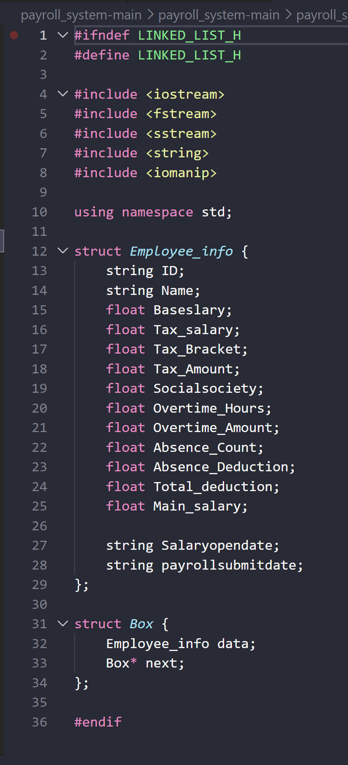
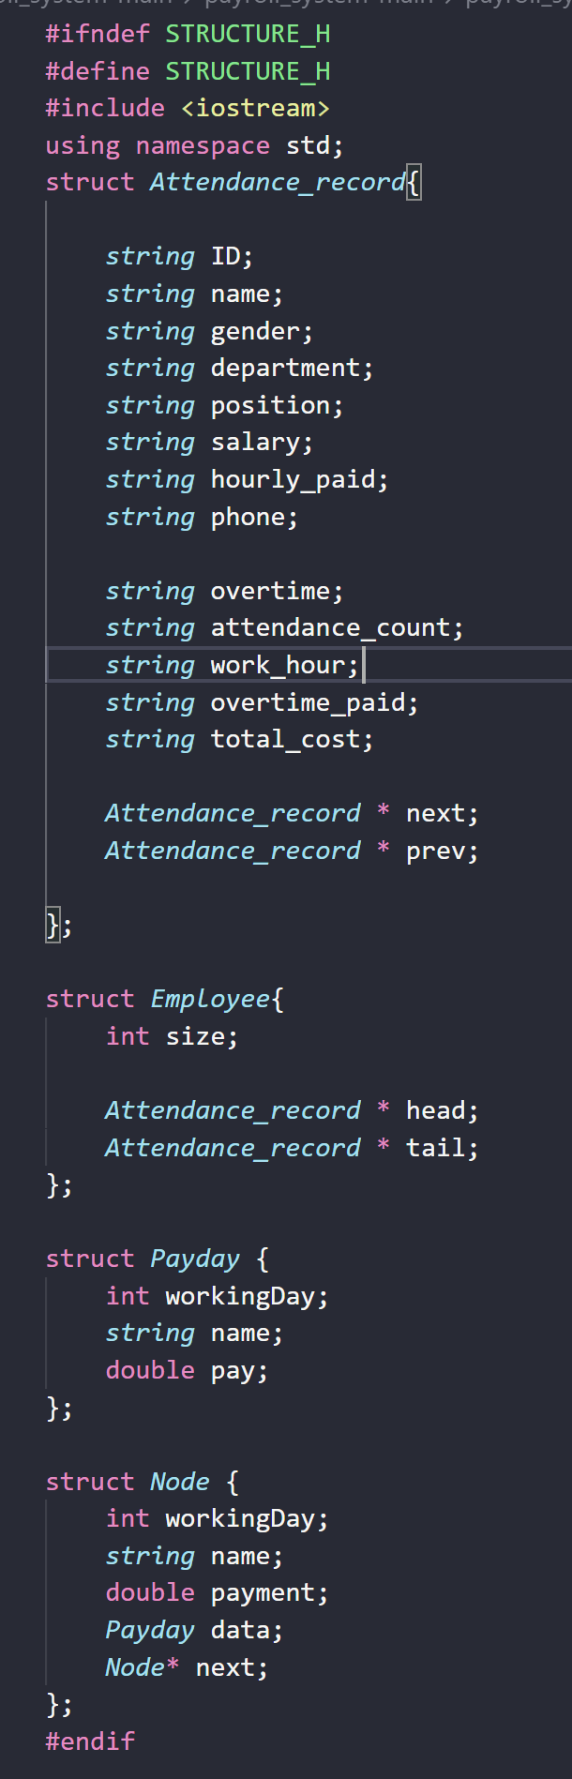
Institute of Technology of Cambodia
Data Structure & Logic
Doubly Linked List Logic
We chose the Doubly Linked List for its flexibility in managing employee nodes:
Dynamic Memory:
Scales without fixed-size arrays.
Bidirectional Traversal:
Easy access to Next and Previous nodes.
Efficiency:
Constant time complexity for insertion and deletion of staff records.
01
02
01
Notes:
This is the heart of our project. We chose a Doubly Linked List over a standard array for three reasons:
Dynamic Memory: We can add or fire employees without worrying about array size limits.
Bidirectional Traversal: We can move forward to the next employee or back to the previous one easily.
Efficiency: Insertion and deletion are much faster than in an array. As you can see in the code snippet, our Employee_info struct contains all the float variables needed for taxes, social society (NSSF), and deductions."

Slide 12

Institute of Technology of Cambodia
File IO
Reading Files
Employee and attendance data are loaded from CSV files into linked lists during program initialization. The system automatically reads existing records at startup, restoring all employee profiles, attendance logs, and payroll data into memory for immediate use.
Writing Files
Updated records are saved back to their respective CSV files after any modifications are made. This ensures full data persistence across sessions — all changes to employee info, attendance, and payroll calculations are retained even after the program closes.
Notes:
To make this a 'Real-World' application, we implemented File Stream (fstream). When you start the program, the Reading function populates the Linked List from the CSV. When you make a change, the Writing function saves the state back to the disk. This ensures that even if there is a power failure, the processed payroll data remains safe in the final_salary.csv

Slide 13
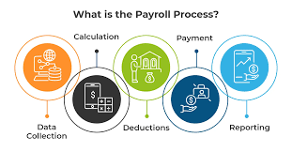

Institute of Technology of Cambodia
System Result
Processing Algorithms
Linear Search
Traverses the list from head to tail to match target IDs for record retrieval.
Bubble Sort
Organizes attendance data in Ascending or Descending order for performance reports.
File Handling
Reads from employee_list.csv and writes back updated payroll information.
Notes:
Let’s talk about the math. Our Salary Calculation follows this strict logic: Final Salary = Base Salary + Overtime Pay - (Tax + Absence Deductions + NSSF). To organize this data, we use Bubble Sort. It compares the attendance counts of employees and swaps their positions in the list to help managers see who is working the most hours or who is frequently absent

Slide 14
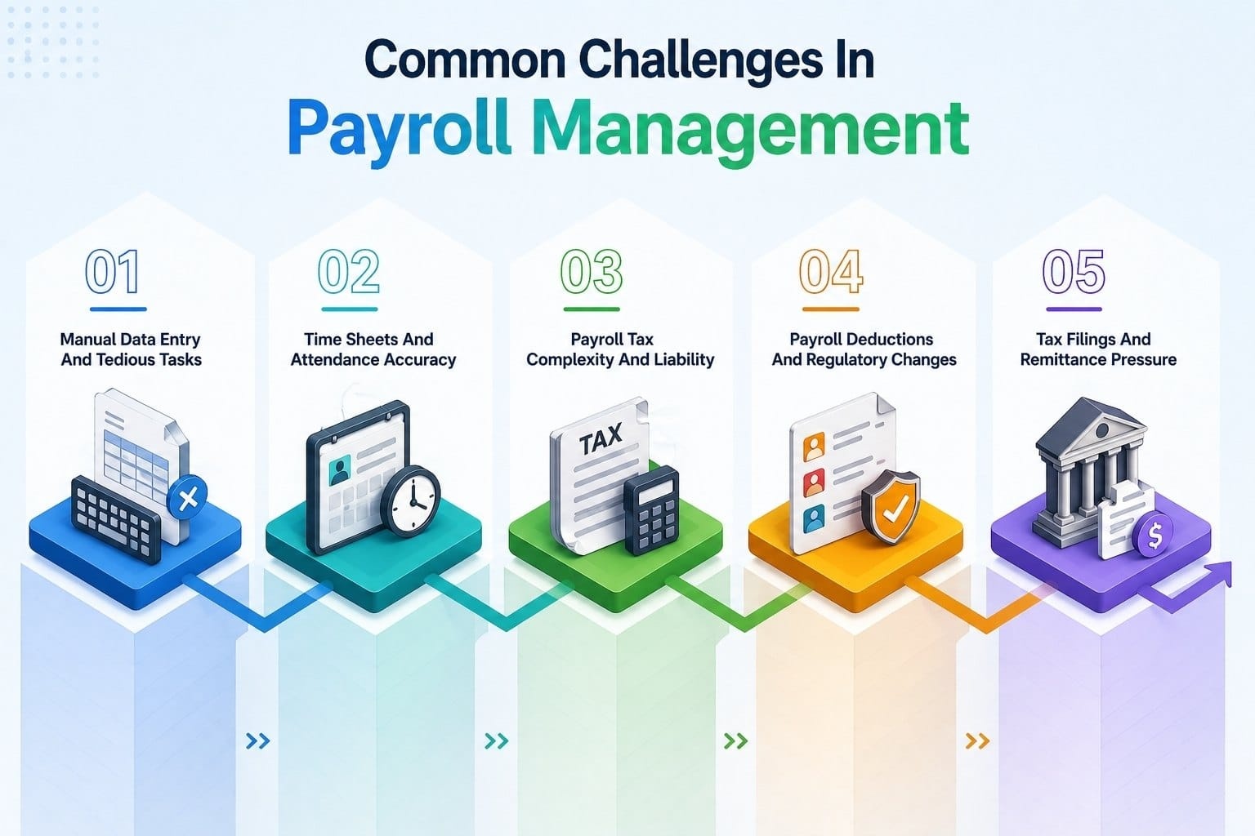
Institute of Technology of Cambodia
SALARY & TAX CALCULATION
The core logic integrates earnings with government tax regulations and attendance deductions.
$${Salary}_{Final}={Salary}_{Base}+{Pay}_{OT}−({Tax}_{Amount}+{Absence}_{Dedu}+Socialsociety)$$
INPUT DATA
ATTENDANCE
CALCULATION
OUTPUT
BASIC SALARY
WORKING HOURS
OVERTIME HOURS
TAX RATE
ATTENDANCE COUNT
OVERTIME = HOURS × HOURLY RATE
ATTENDANCE DEDUCTION APPLIED
TAX AMOUNT = TAX_SALARY × (TAX RATE_BRACKET/100)
AUTOMATED COMPUTATION
FINAL SALARY = BASIC + OVERTIME − TAX_AMOUNT− ABSENCE- NSSF

Slide 15


Institute of Technology of Cambodia
System Result & Validation
Test Case Success
Extensive testing ensured that the system handles edge cases effectively:
Accurate processing of large attendance CSVs.
Proper tax application across different salary tiers.
Validation of ID search and sorting results.
Successful "Submit Payroll" file persistence.
Verified CSV Output
final_Salary.csv
Notes:
We tested the system with various edge cases. For example:
What happens if an employee has zero absences?
What if they fall into the highest tax bracket? The system successfully validated these cases, producing a clean final_Salary.csv and a verified tax_report.csv for government submission.

Slide 16
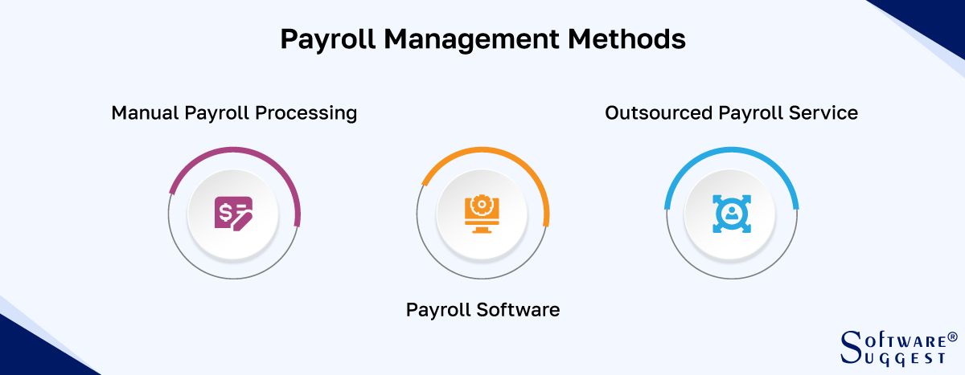

Institute of Technology of Cambodia
Conclusion & Learning
Summary of Achievements
The project successfully integrated data structures with real-world business requirements.
Practical mastery of Linked Lists.
Robust understanding of File I/O in C++.
Enhanced problem-solving and logic skills.
Team coordination and modular design.
01
02
Learning Outcomes
“Combining Program Logic with administrative efficiency to create meaningful software solution”
03
04
Notes:
In conclusion, this project was more than just a coding exercise. We achieved:
Practical mastery of Linked Lists.
A deep understanding of File Handling.
And most importantly, Team Coordination. We learned how to combine administrative efficiency with program logic to create a software solution that actually solves a business problem.“ So now let throw to the demo code

Slide 17
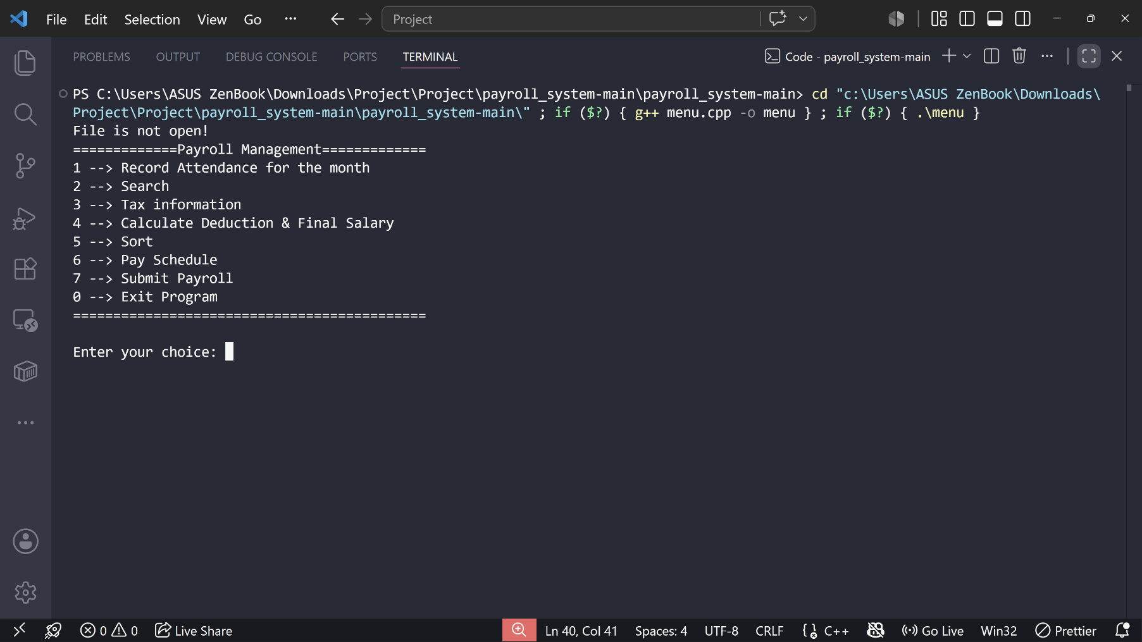
Institute of Technology of Cambodia
Demo code

Slide 18
Institute of Technology of Cambodia
Thank
You
For Your Attention

